Slide 1
Feature Extraction and Price Prediction for Mobile Phones
By: Garima Mahajan

Slide 2
Project Overview
Data Cleaning and Preprocessing
Column Management: Dropped unnecessary columns to focus on relevant data for analysis.
Data Types and Summary: Checked and corrected data types, reviewed the dataset summary, and treated any remaining missing values.
Outliers and Skewness: Identified and treated outliers, assessed the skewness of the data, and performed necessary transformations to normalize distributions.
Correlation Analysis: Calculated correlations to understand relationships between features.
Exploratory Data Analysis (EDA)
Box-Plots: Constructed box-plots to visualize the distribution of the data and observe the effect of outlier treatment.
Heatmap: Created a heatmap to visualize correlations between features and the prize amount, identifying key influencing factors.
Groupby and Feature Importance: Plotted various EDA graphs using the Groupby function to highlight important features affecting the prize.
Feature Engineering
New Feature Development: Generated new features to enhance model performance, capturing more complex patterns and relationships within the data.

Slide 3
Project Overview
Model Development
Data Splitting: Split the dataset into training and testing sets to evaluate model performance.
Model Selection: Evaluated multiple regression algorithms, including:
Linear Regression: For a simple, interpretable baseline model.
Random Forest Regressor: To capture non-linear relationships and interactions between features.
Gradient Boosting Regressor: For its ability to improve accuracy through iterative boosting.
Hyperparameter Tuning: Used techniques such as Grid Search and Random Search to find the optimal parameters for each model.
Model Training: Trained the selected models on the training data.
Model Evaluation: Assessed model performance using metrics like Mean Absolute Error (MAE), Mean Squared Error (MSE), and R-squared (R²) on the test data.
Model Comparison: Compared the performance of different models to select the best one for predicting mobile phone prizes.

Slide 4
Methodology
Libraries used:
Pandas: Data manipulation library that provides data structures like DataFrames for easy handling and analysis of structured data.
NumPy: Fundamental library for numerical computing in Python, offering powerful array objects and mathematical functions for array operations.
Matplotlib: Comprehensive plotting library for creating static, interactive, and publication-quality visualizations in Python.
Seaborn: Statistical data visualization library that works well with Pandas and Matplotlib, offering high-level functions for creating informative statistical plots.
StandardScaler: Was used to standardizes features by removing the mean and scaling to unit variance
The code was executed in Google Colab notebook.

Slide 5
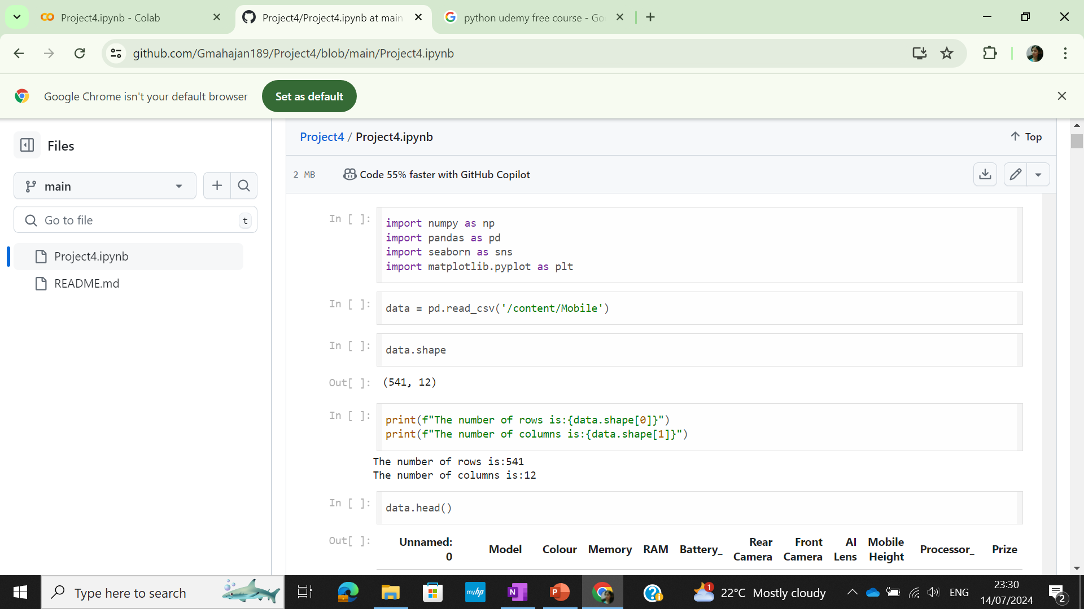
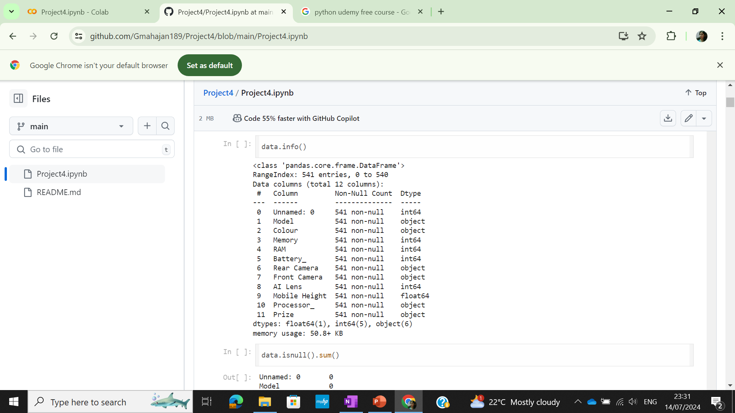
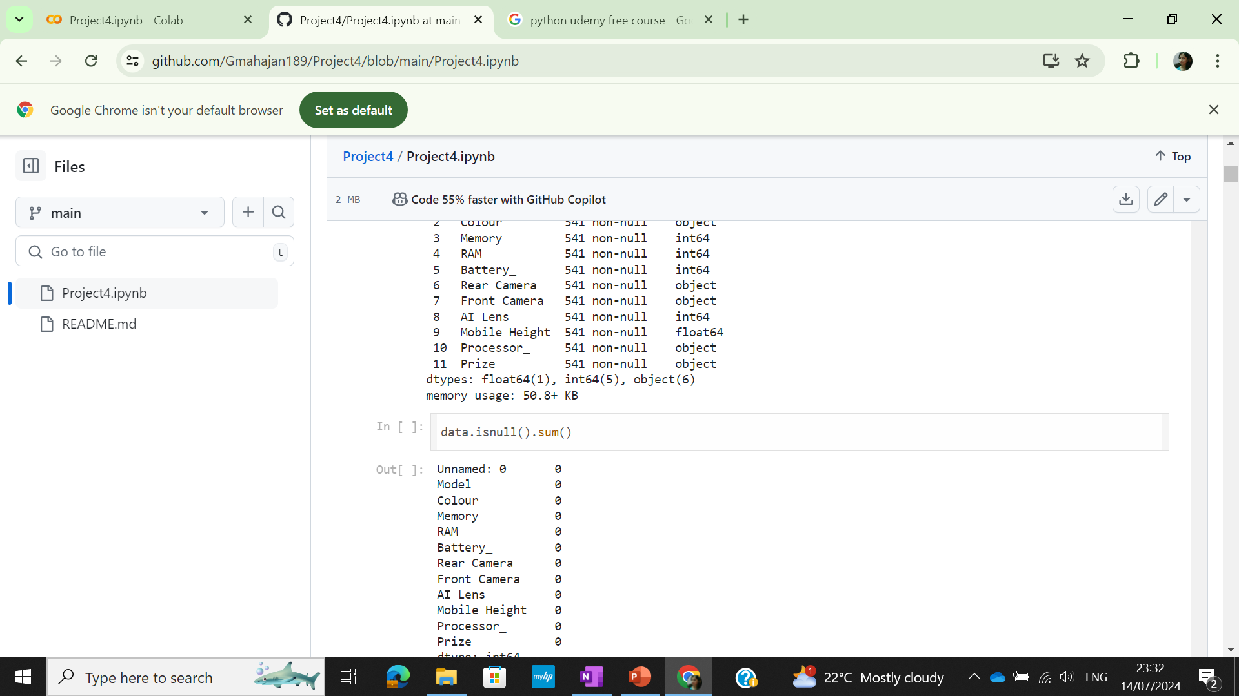
Solution
Importing the libraries
To read the csv file
To check dimension of the dataset
To check the first 5 rows
To check the data info
To get data null values

Slide 6
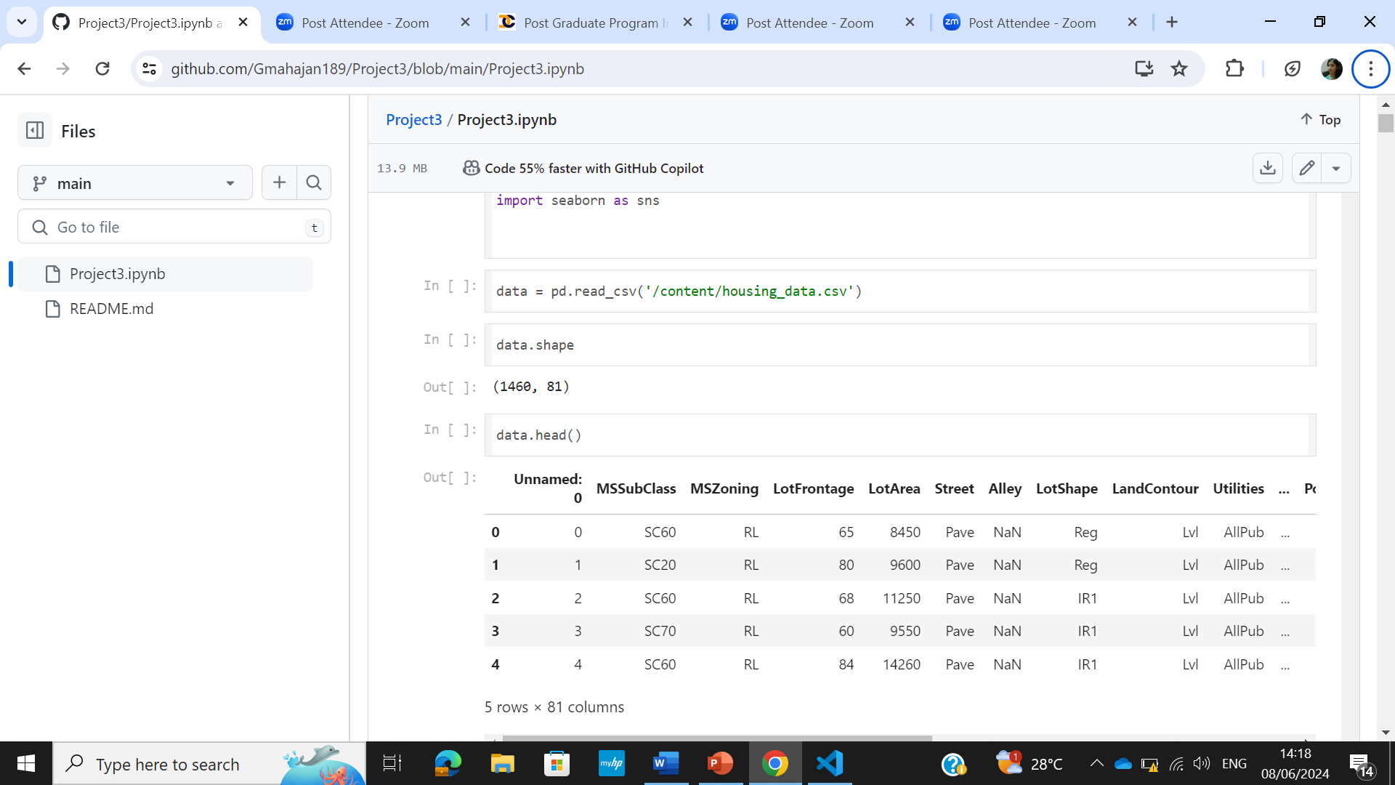
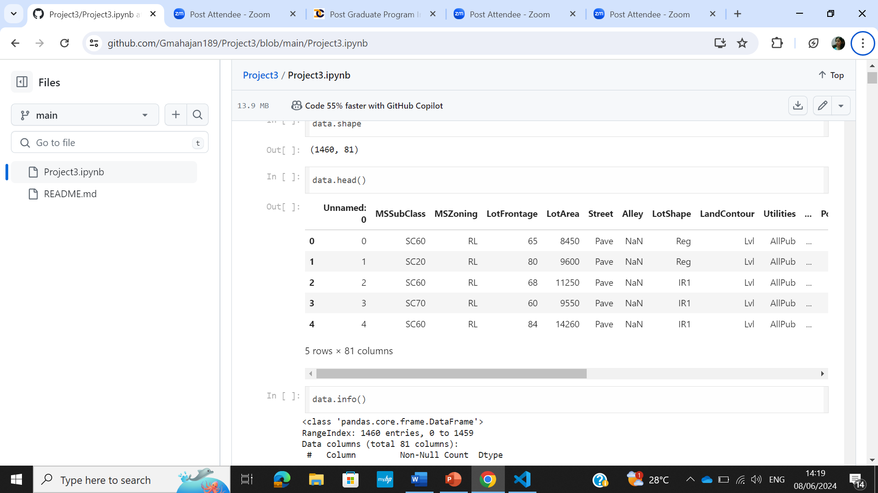
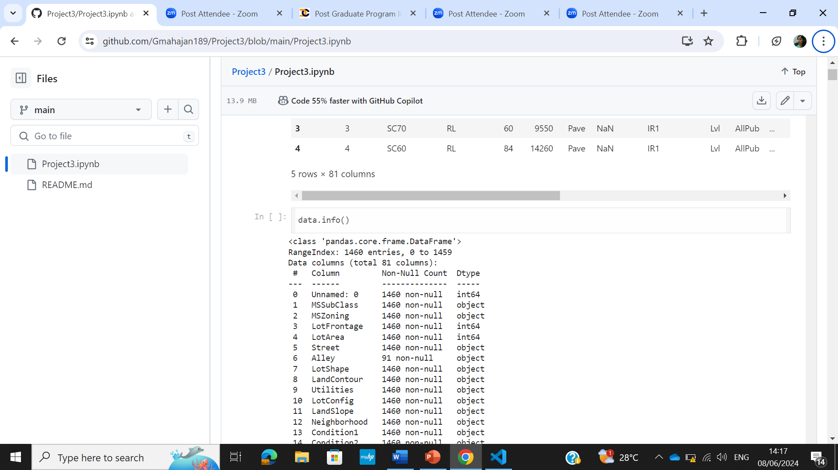
Solution
To read the excel file into pandas dataframe
To see the top 5 entries in the dataset
For the dataset information

Slide 7
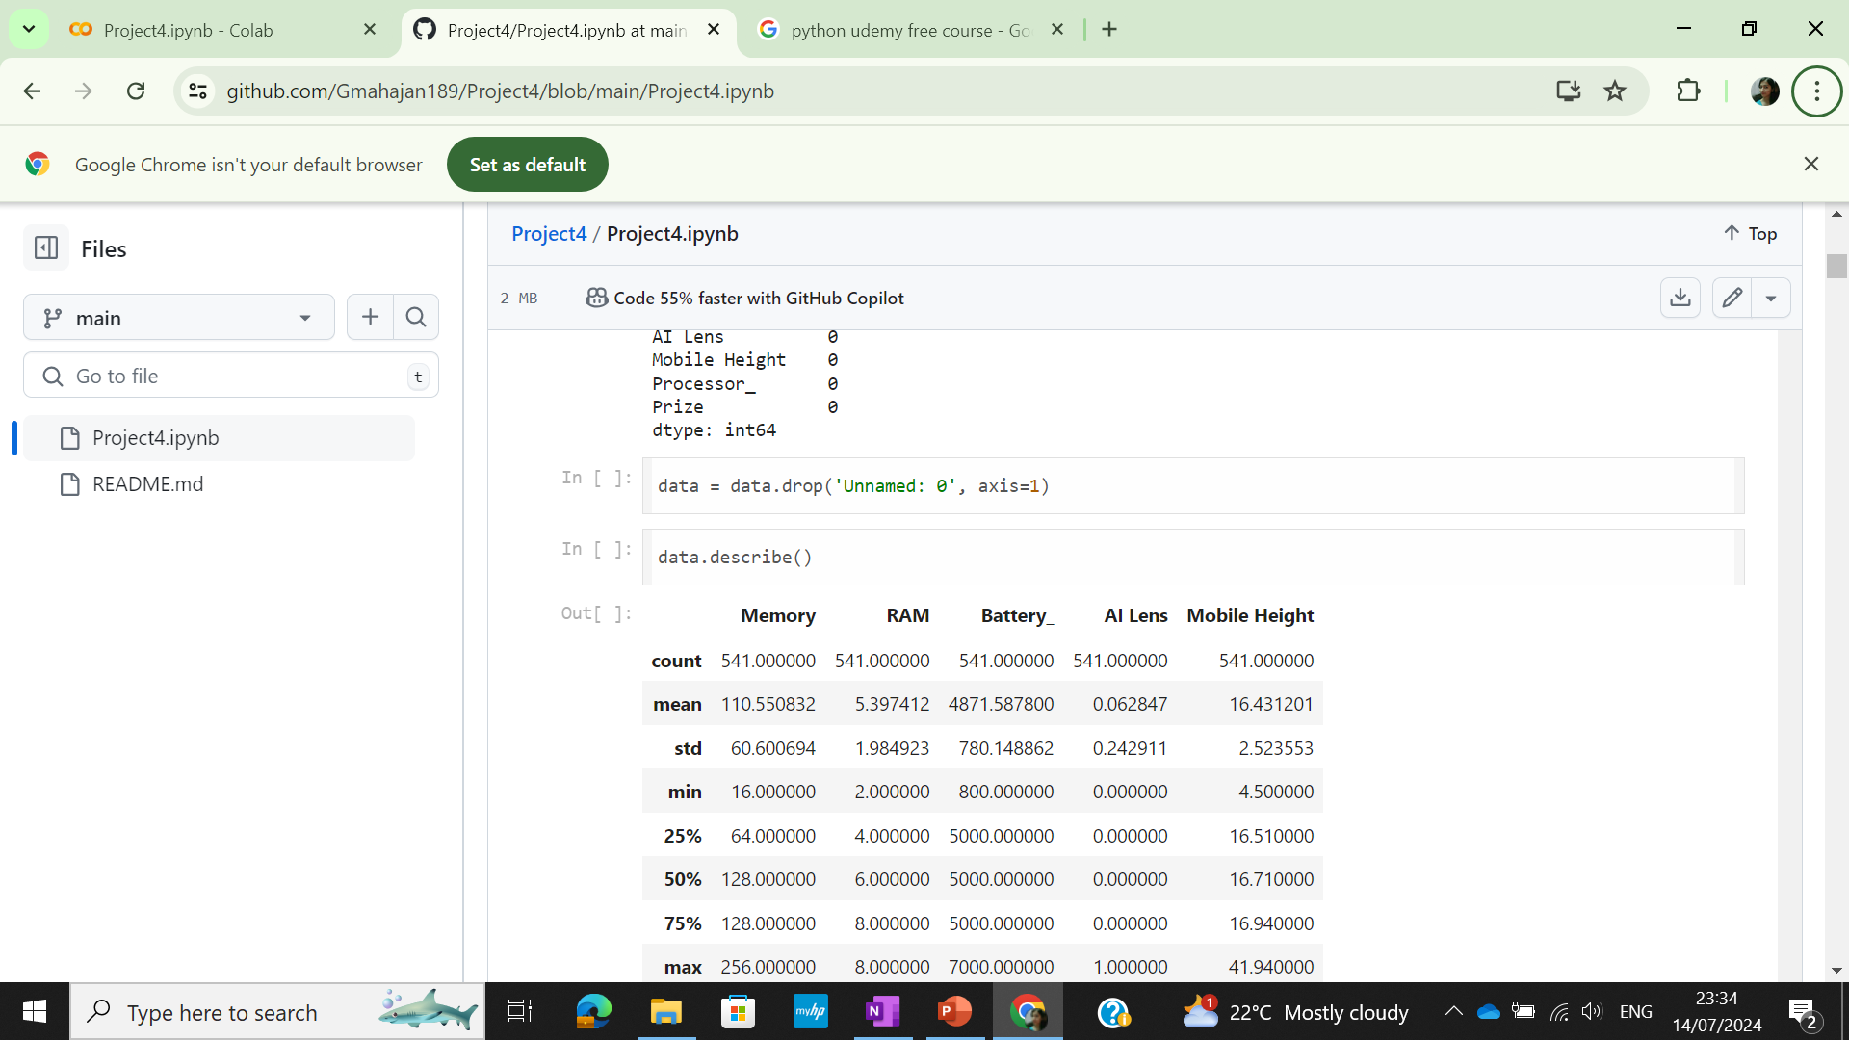
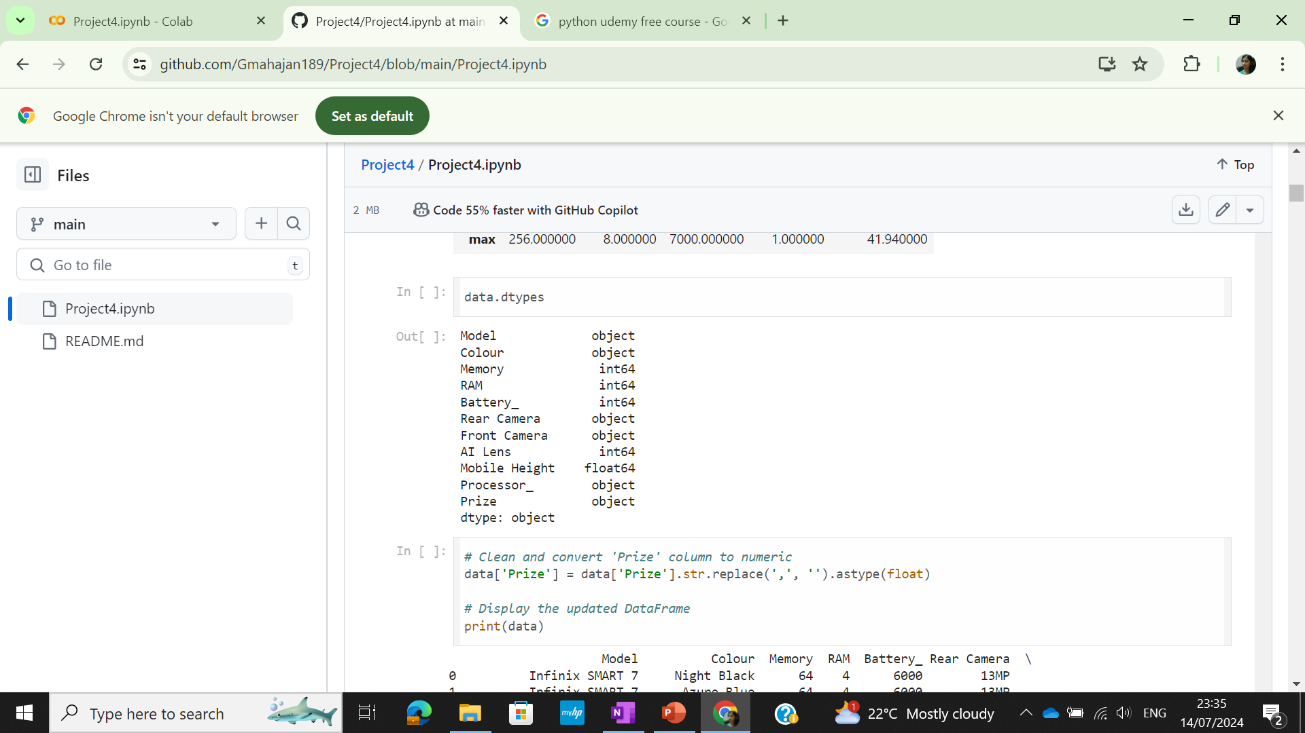
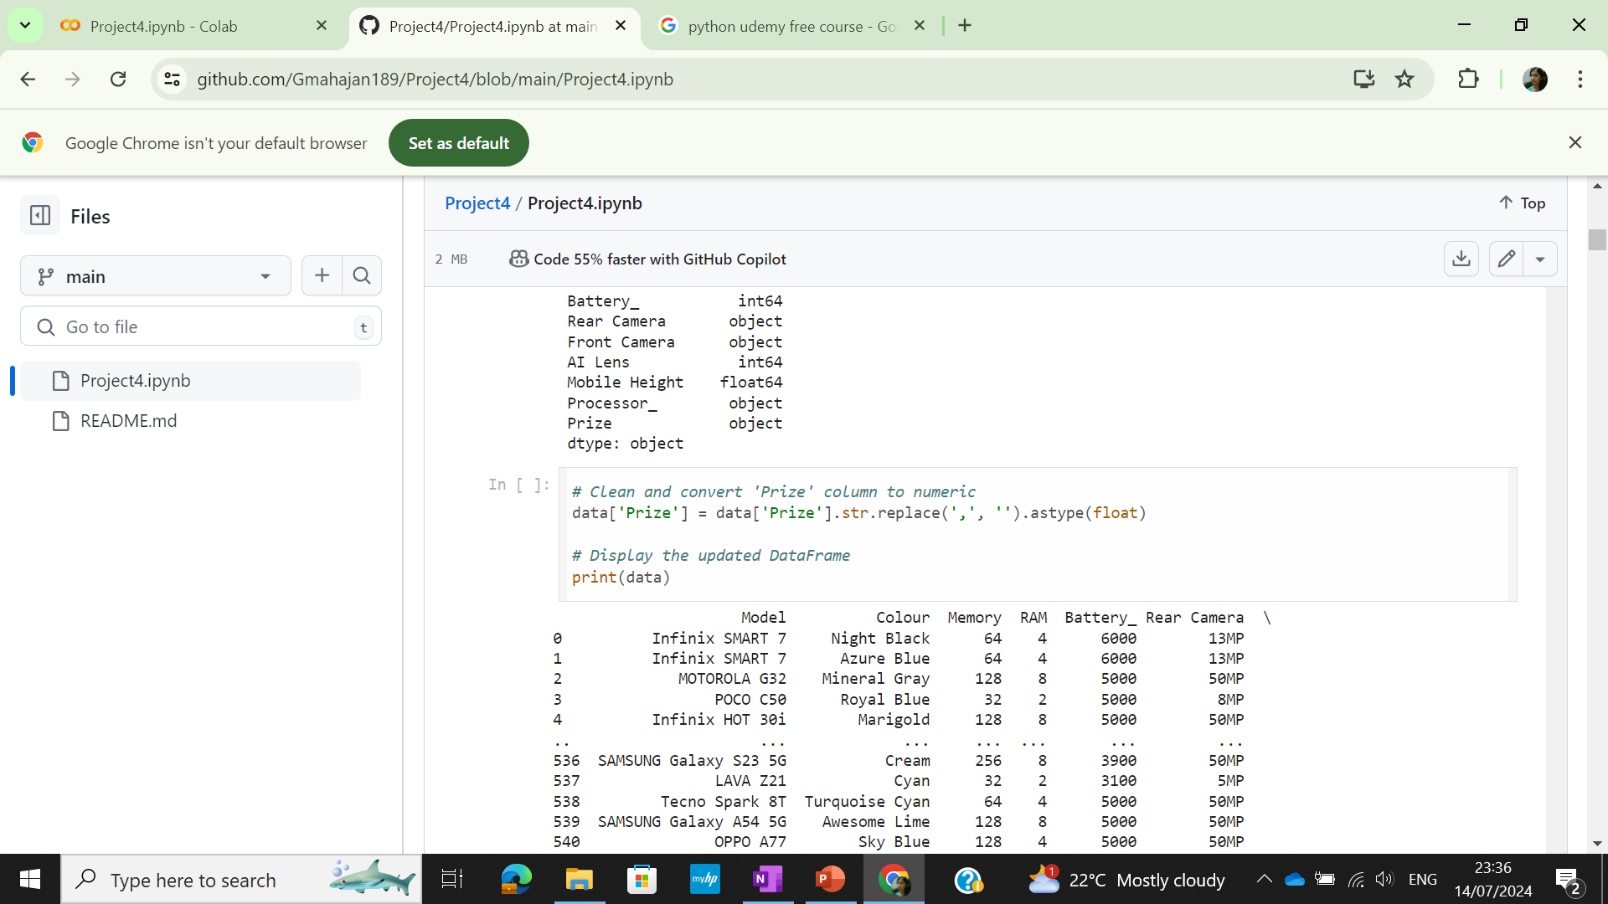
Solution
To drop the column
To convert prize column from object to float(numeric)
To check the datatypes of the dataset

Slide 8
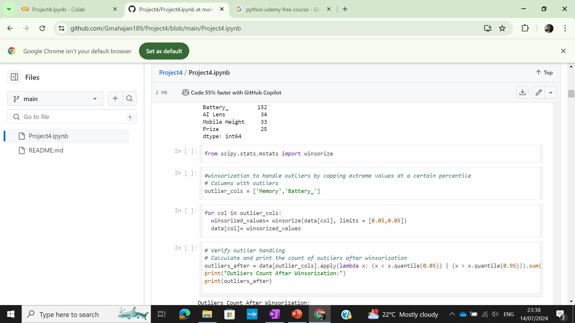
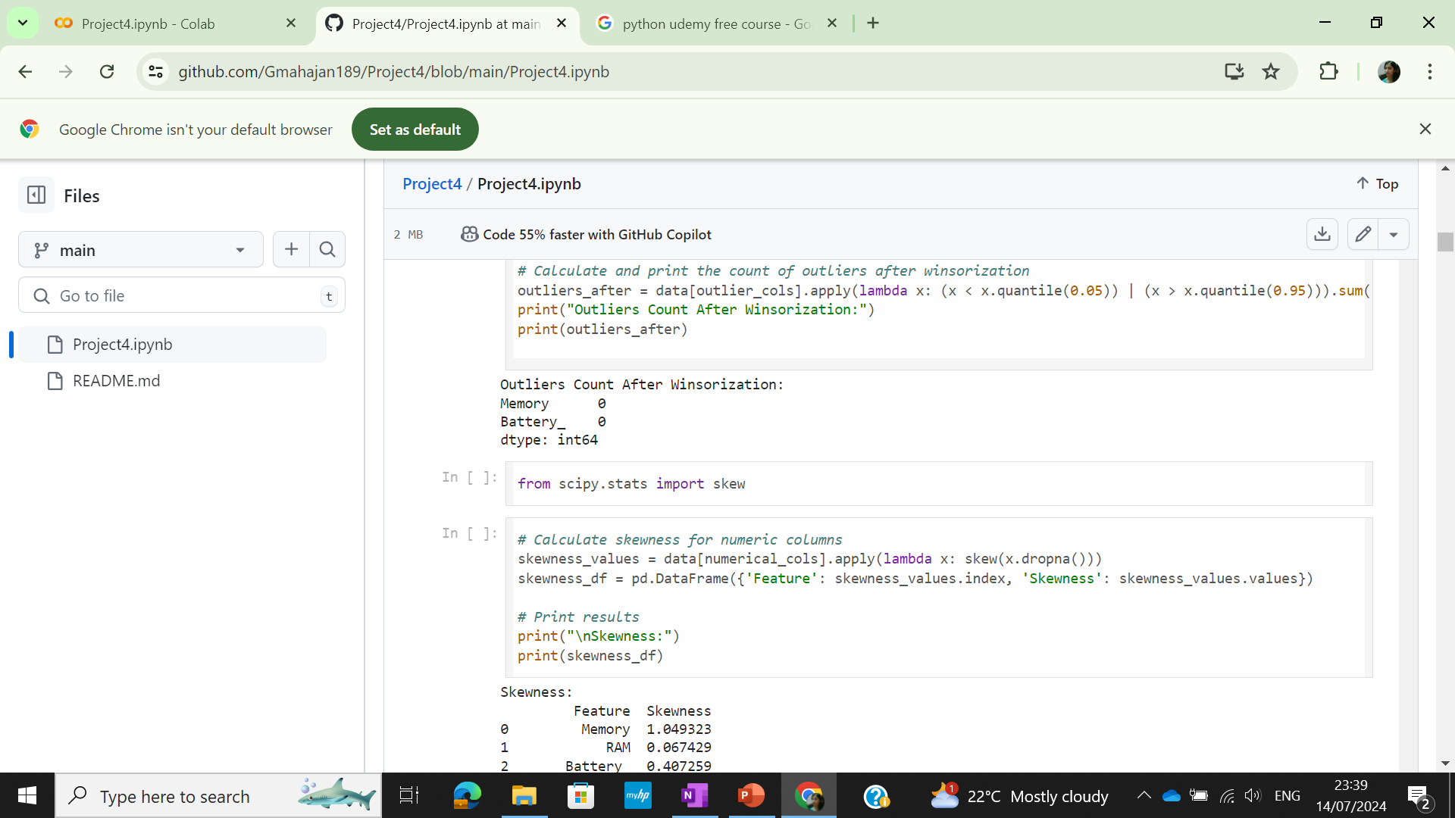
Solution
Winsorization was used to handle outliers
Skewness of the data was checked

Slide 9
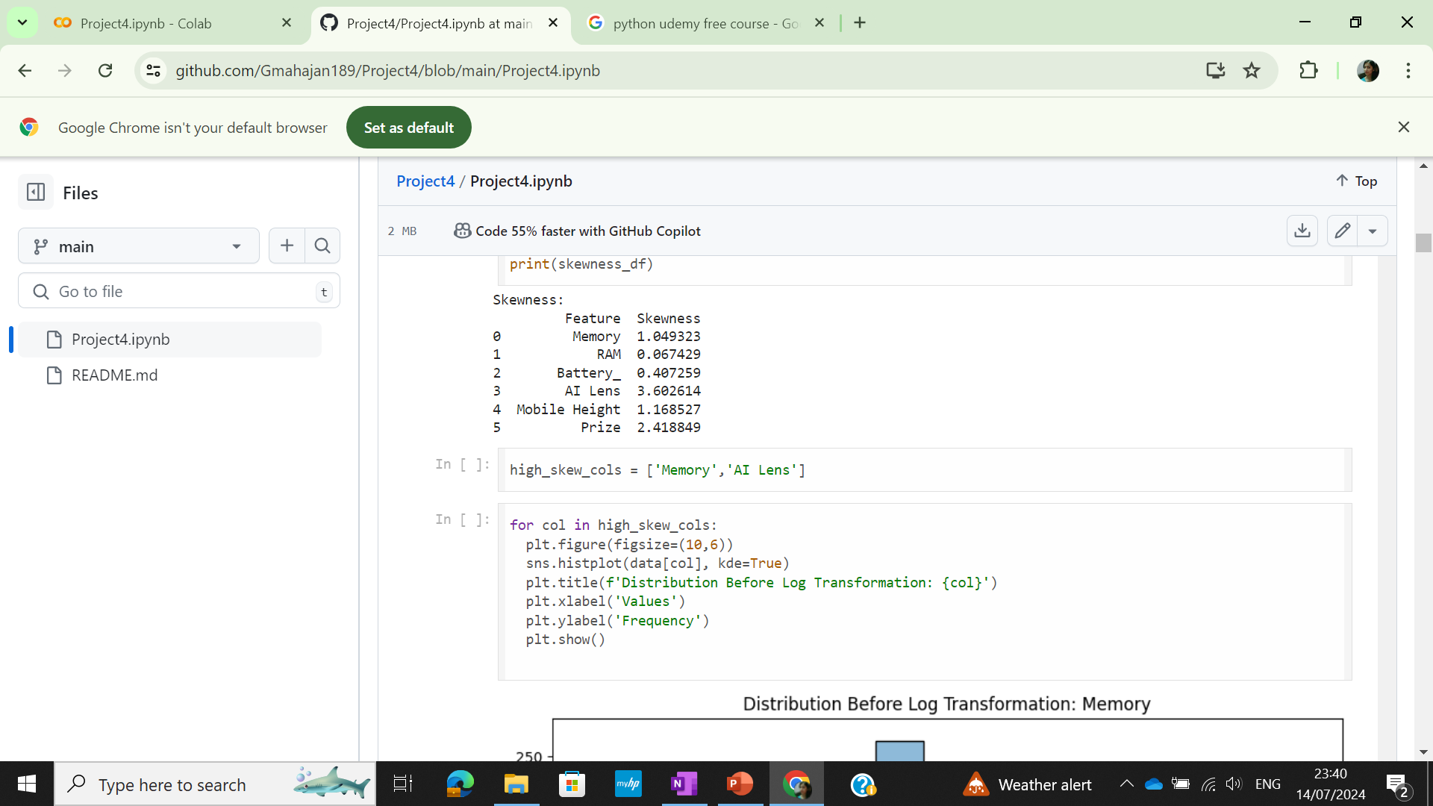
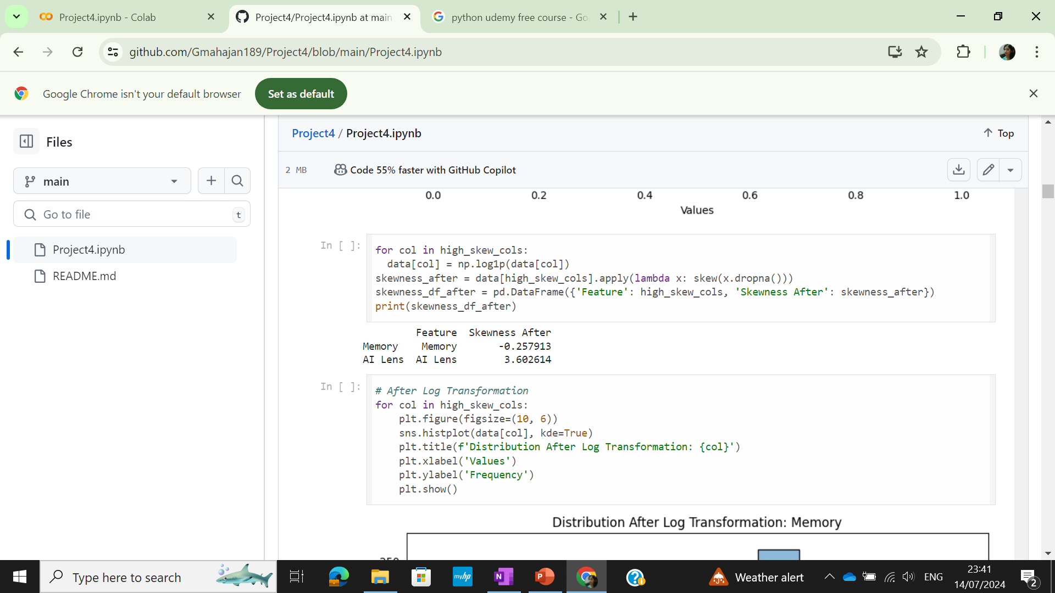
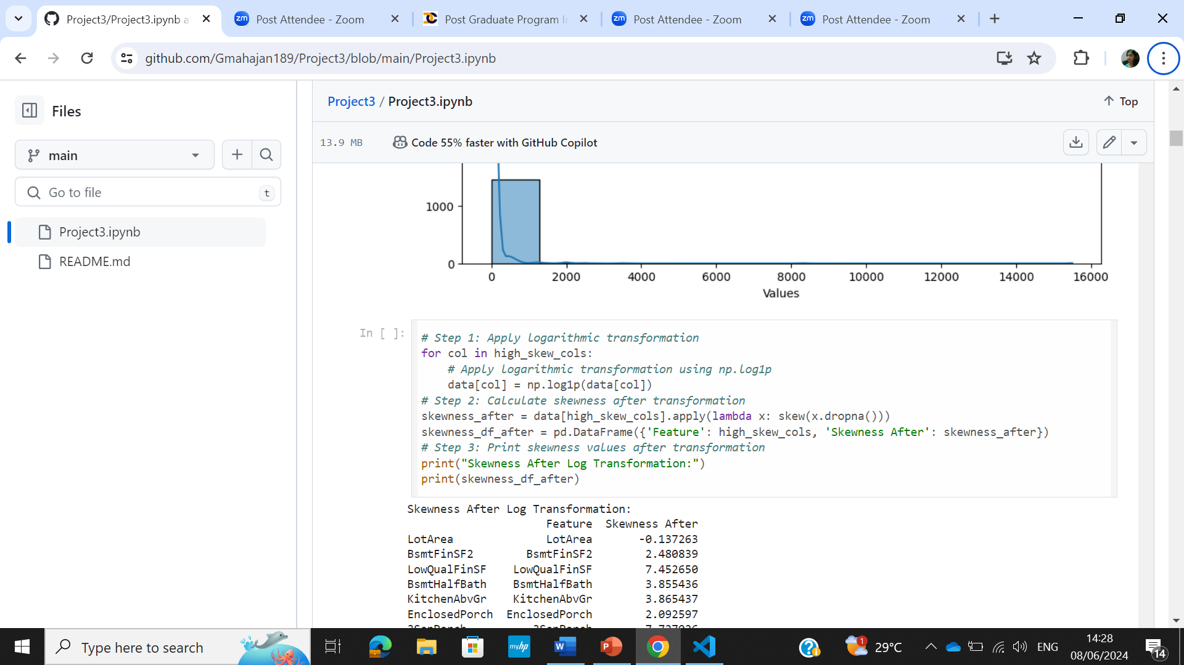
Solution
To check the distribution before transformation using histogram
The high skew columns were normalized using logarithmic transformation

Slide 10
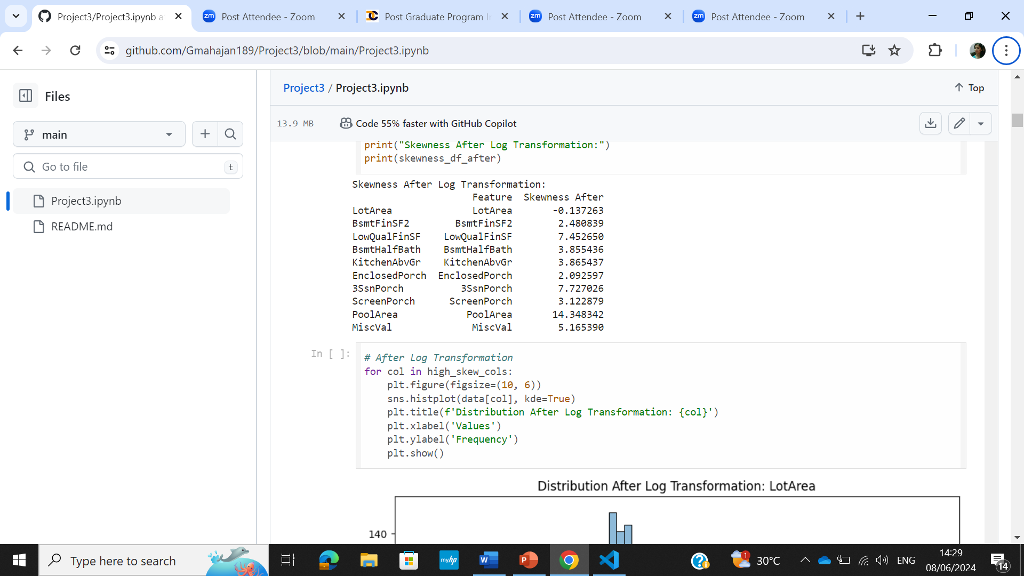
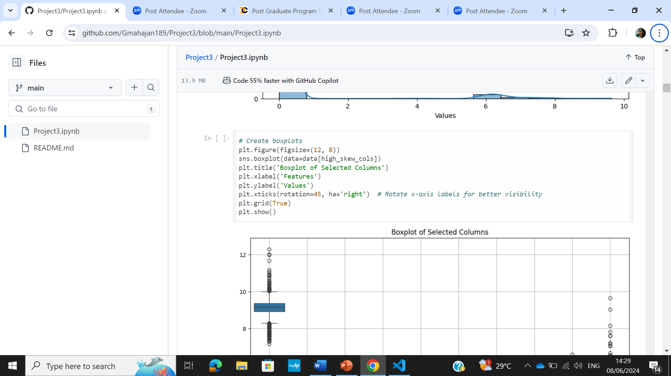
Solution
After logarithmic transformation skewness was checked and distribution was plotted
To construct the box-plot for the selected columns

Slide 11
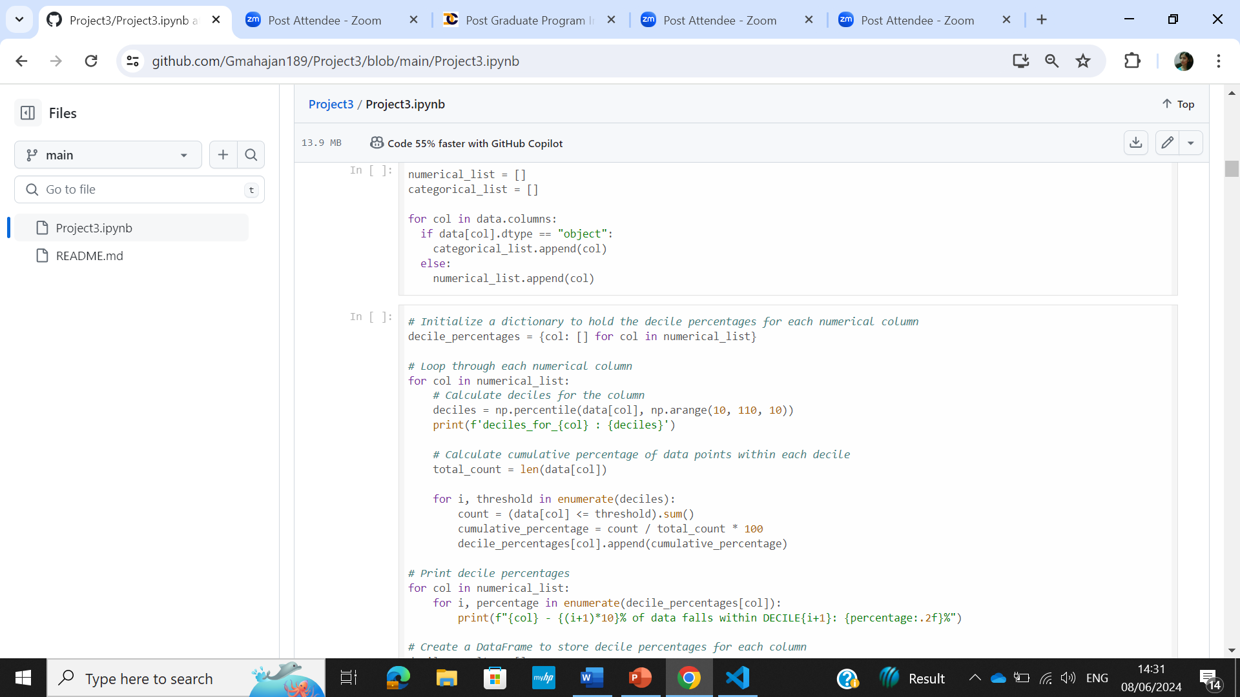
Solution
Numerical and Categorical list was made
The decile percentages for each column were calculalated to know how the data is distributed within every decile

Slide 12
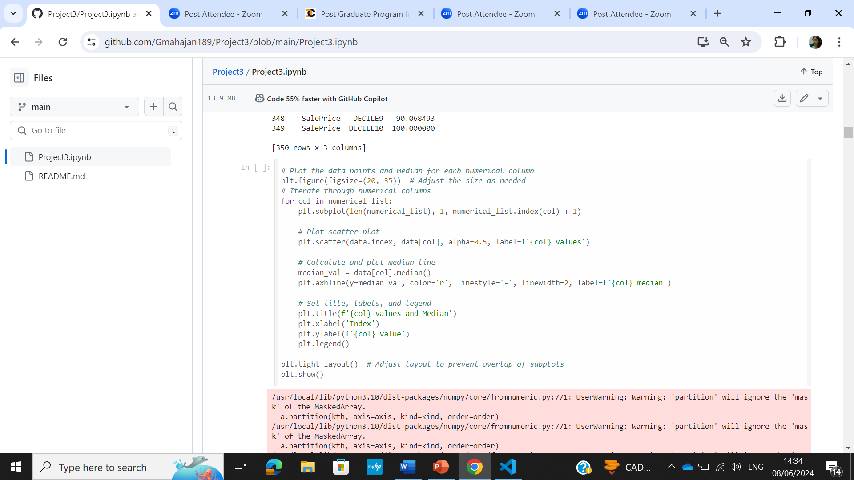
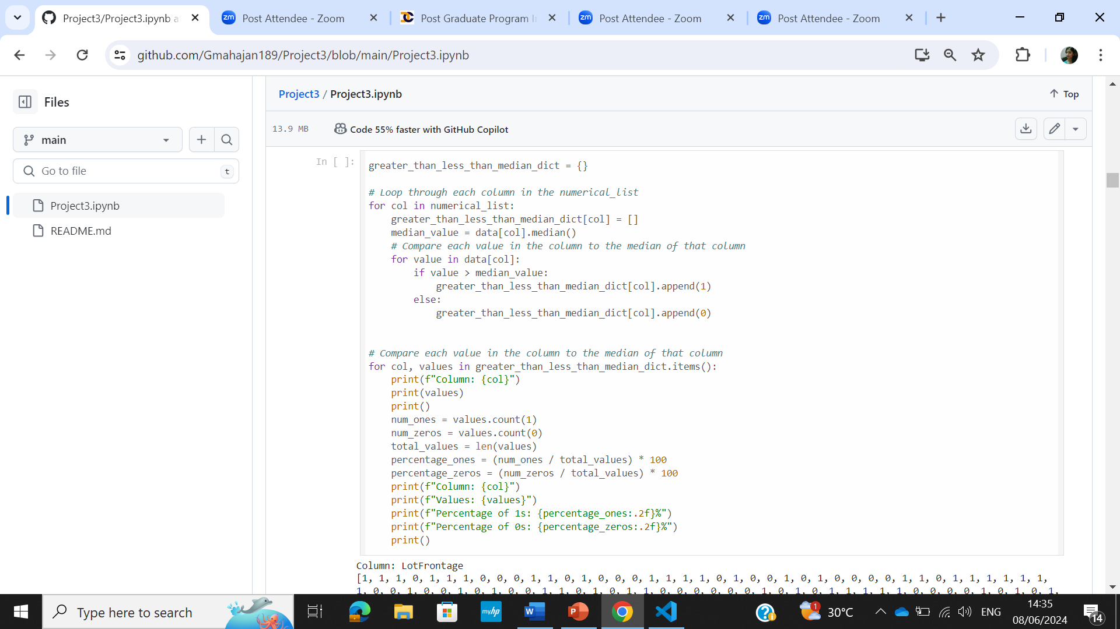
Solution
Data distribution for each column along the median was plotted using scatter plot
Dictionary was made and the percentage data greater than,less than median was stored

Slide 13
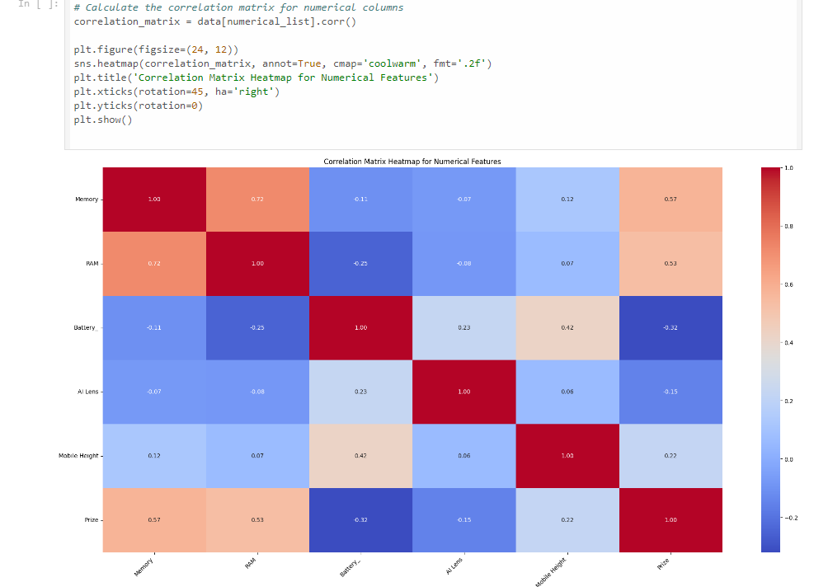
Solution
To calculate the correlation matrix for the selected columns and create heatmap to visualize the correlation

Slide 14
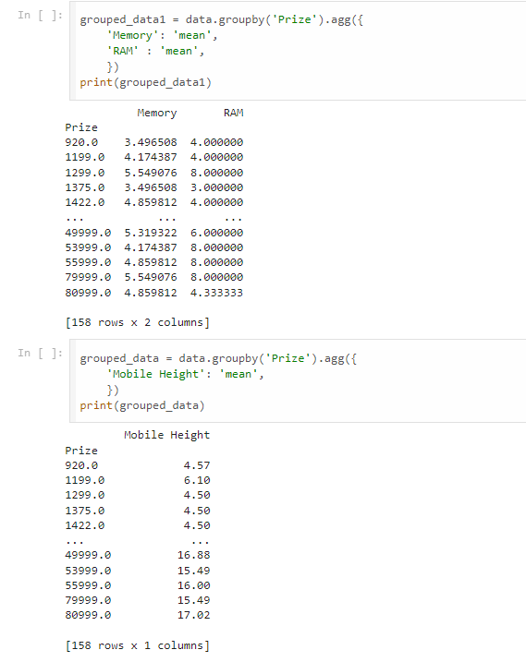
Solution
Data was grouped using Groupby on ‘Prize’ and aggregated on Memory,RAM mean
Data was grouped using Groupby on ‘Prize’ and aggregated on Mobile Height mean

Slide 15
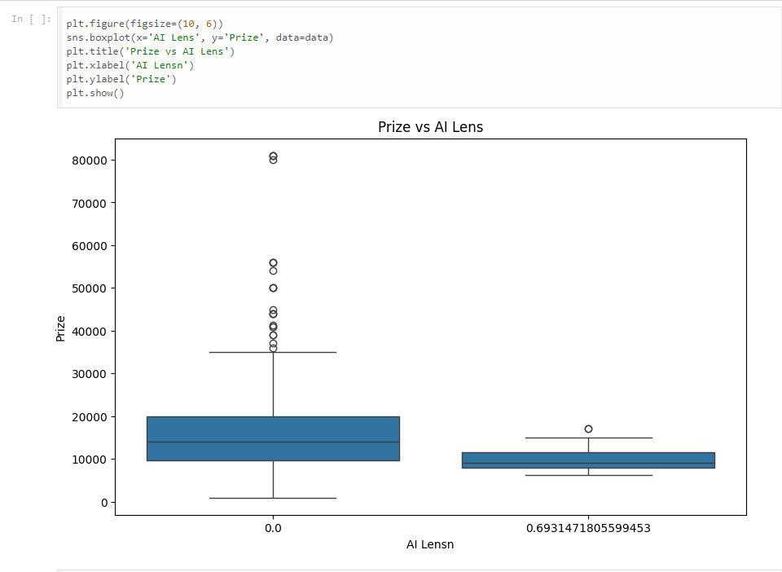
Solution
Boxplot was made for Prize vs AI Lens
When the AI lens is not used (0.0), prize amounts are generally higher and more variable, with a significant number of high-value outliers.
When the AI lens is used (0.69), prize amounts are lower on average, with less variability and fewer high-value outliers.

Slide 16
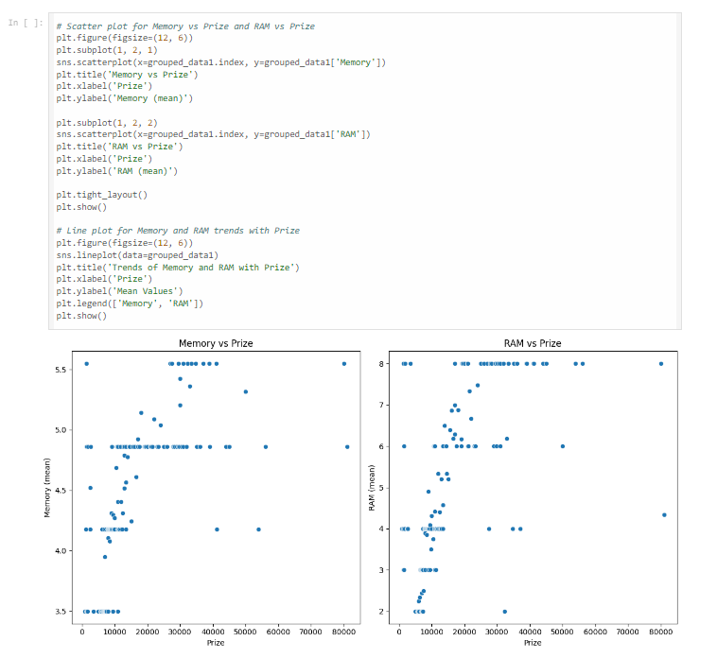
Solution
Scatterplot was made between Memory and Prize, Memory and RAM
To visualize the relationship between the variables

Slide 17
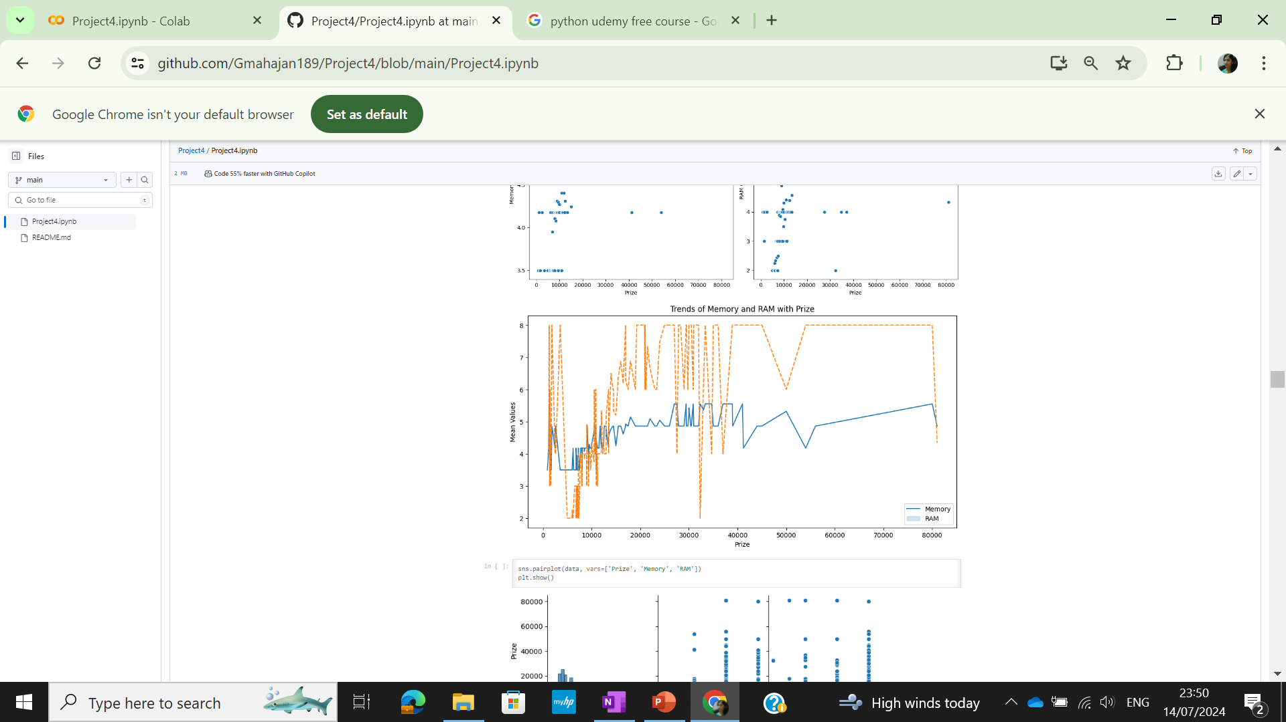
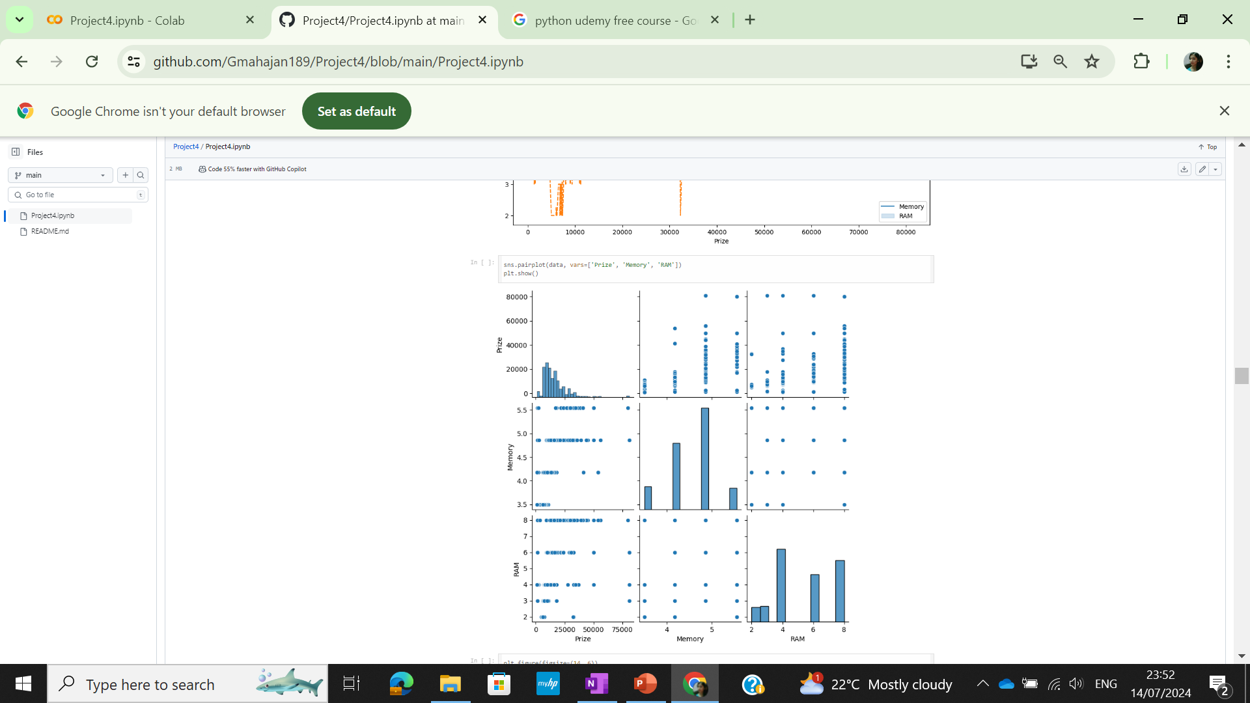
Solution
Lineplot to see Memory and RAM Trend with Prize
Pairplot to visualize relationship between the variables

Slide 18
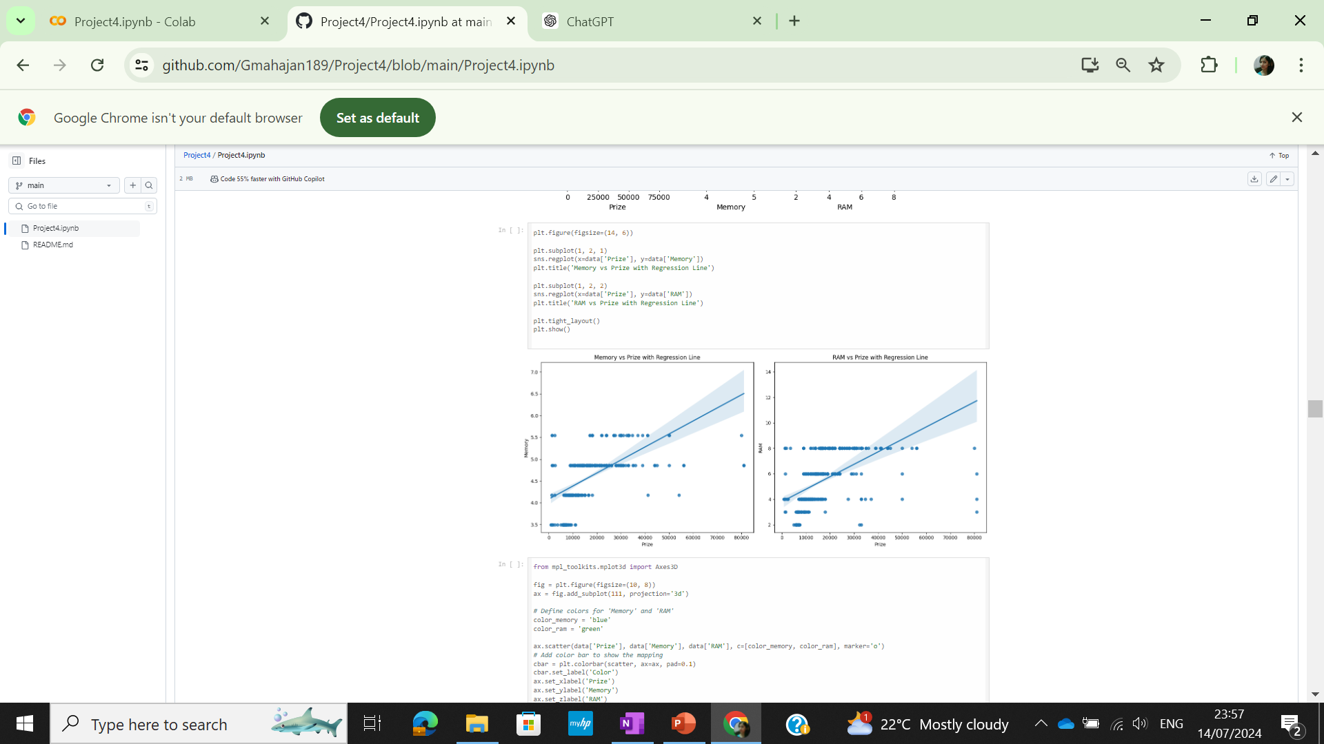
Solution
Scatterplot with regression line to understand the correlation between prize, memory and prize,RAM

Slide 19
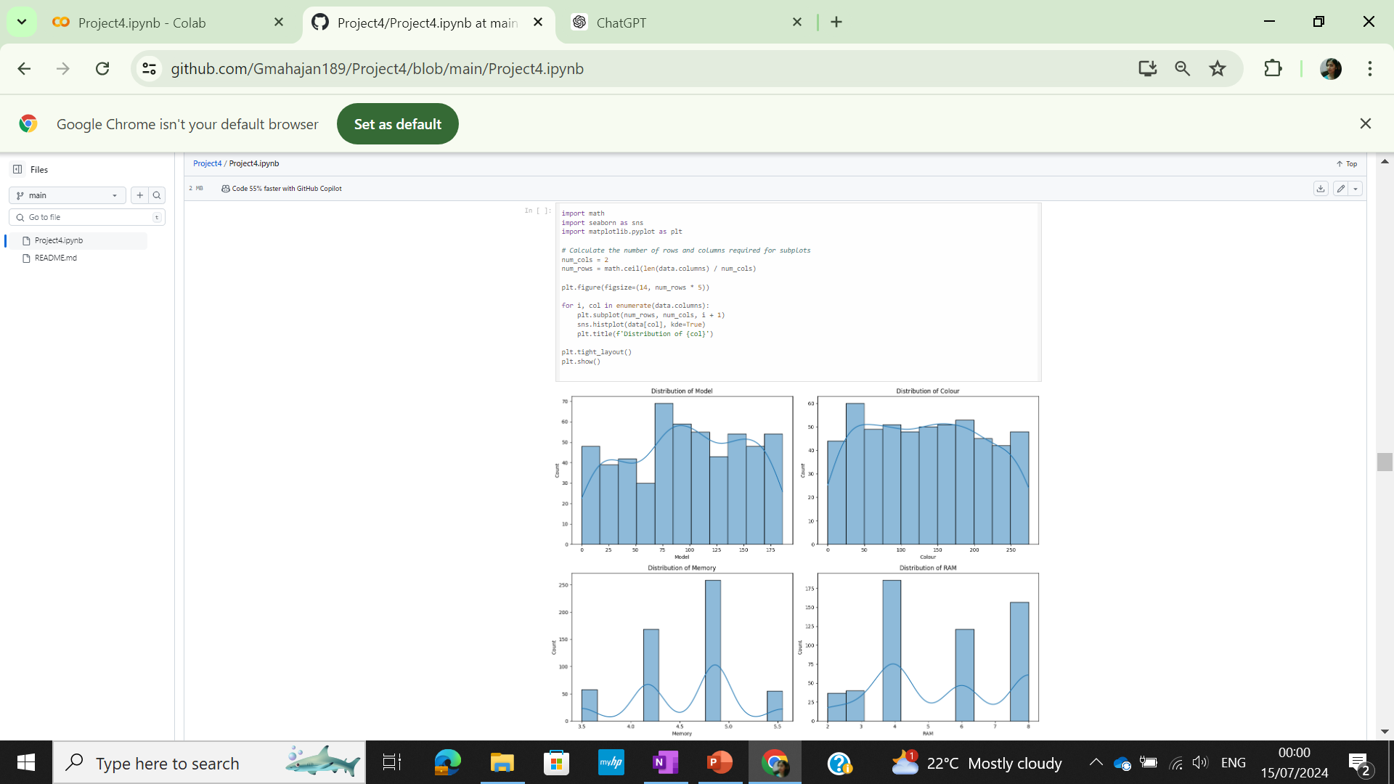
Solution
Distribution for all features visualized using Histograms

Slide 20
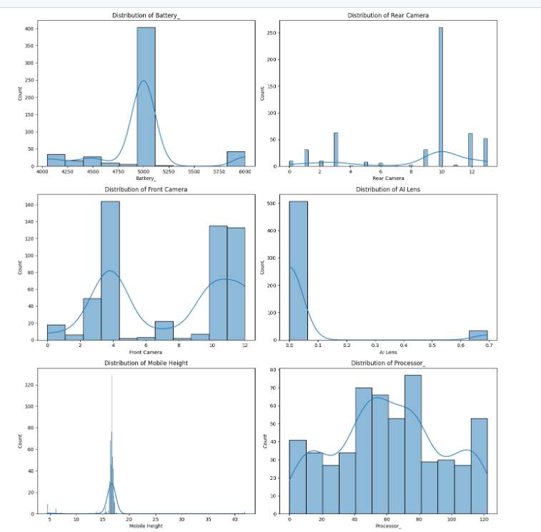
Solution
Distribution for all features visualized using Histograms

Slide 21
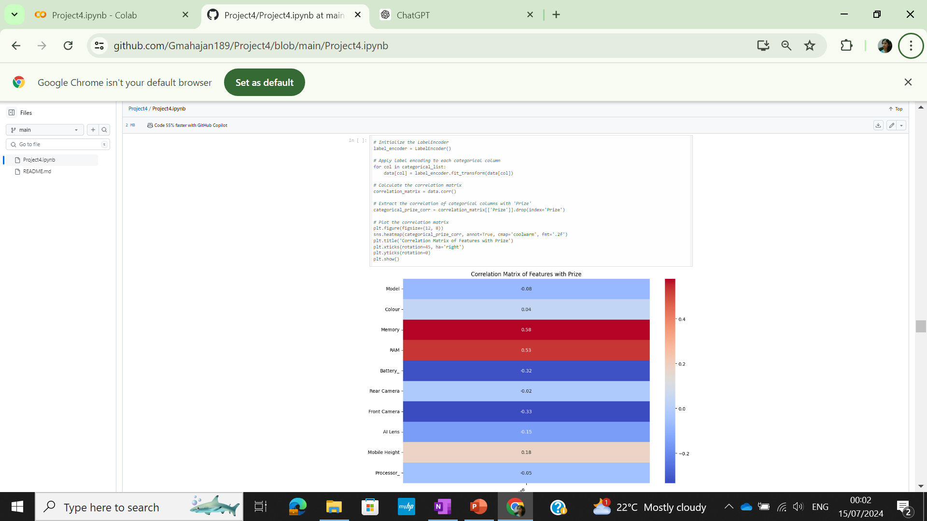
Solution
Heatmap plotted for correlation matrix and correlation of all features with prize checked . Memory,RAM have the highest positive correlation with prize

Slide 22
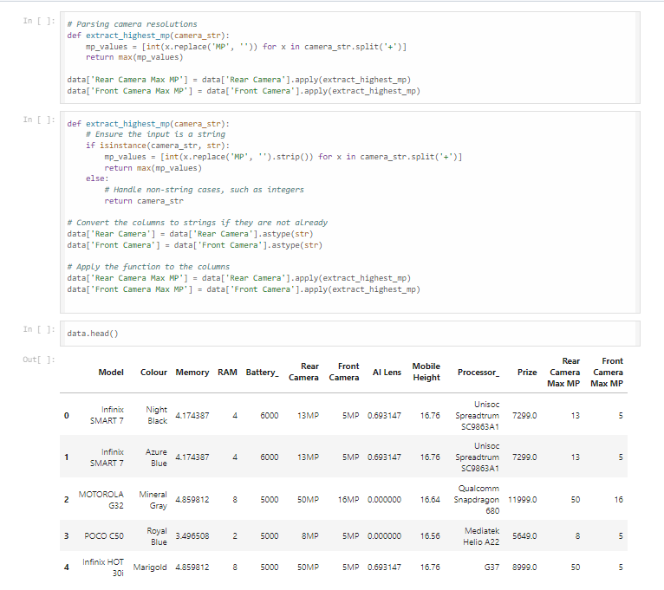
New Features Generation
New Features were generated using the def function- Rear Camera Max MP and Front Camera Max MP and introduced into dataset

Slide 23
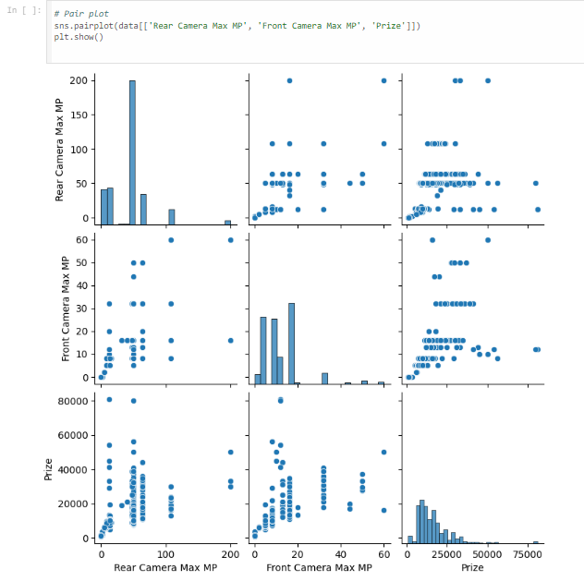
EDA Plots
Pair plot that includes scatter plots and histograms to visualize the relationships and distributions among three variables: Rear Camera Max MP, Front Camera Max MP, and Prize.

Slide 24

EDA Plots
Rear Camera Max MP
- Higher rear camera MP values consistently correlate with higher prize amounts. The variability increases with MP, with significant outliers indicating potential high-value prizes.
Front Camera Max MP
- The relationship between front camera MP and prize amounts is less linear, showing significant variability. There is a noticeable peak around 12-13 MP, with higher prizes and more variability at higher MP values (50 MP).

Slide 25

Model Development
Dataset splitted into Training and Test data
Target column(Y) set as Prize and dropped from X. Model chosen as Linear Regression as the target Prize is Continuous variable
MAE,MSE,R-squared imported as these are the performance metrics for a Regression Problem
Performance metrics evaluated for the Linear Regresssion model to assess model performance

Slide 26
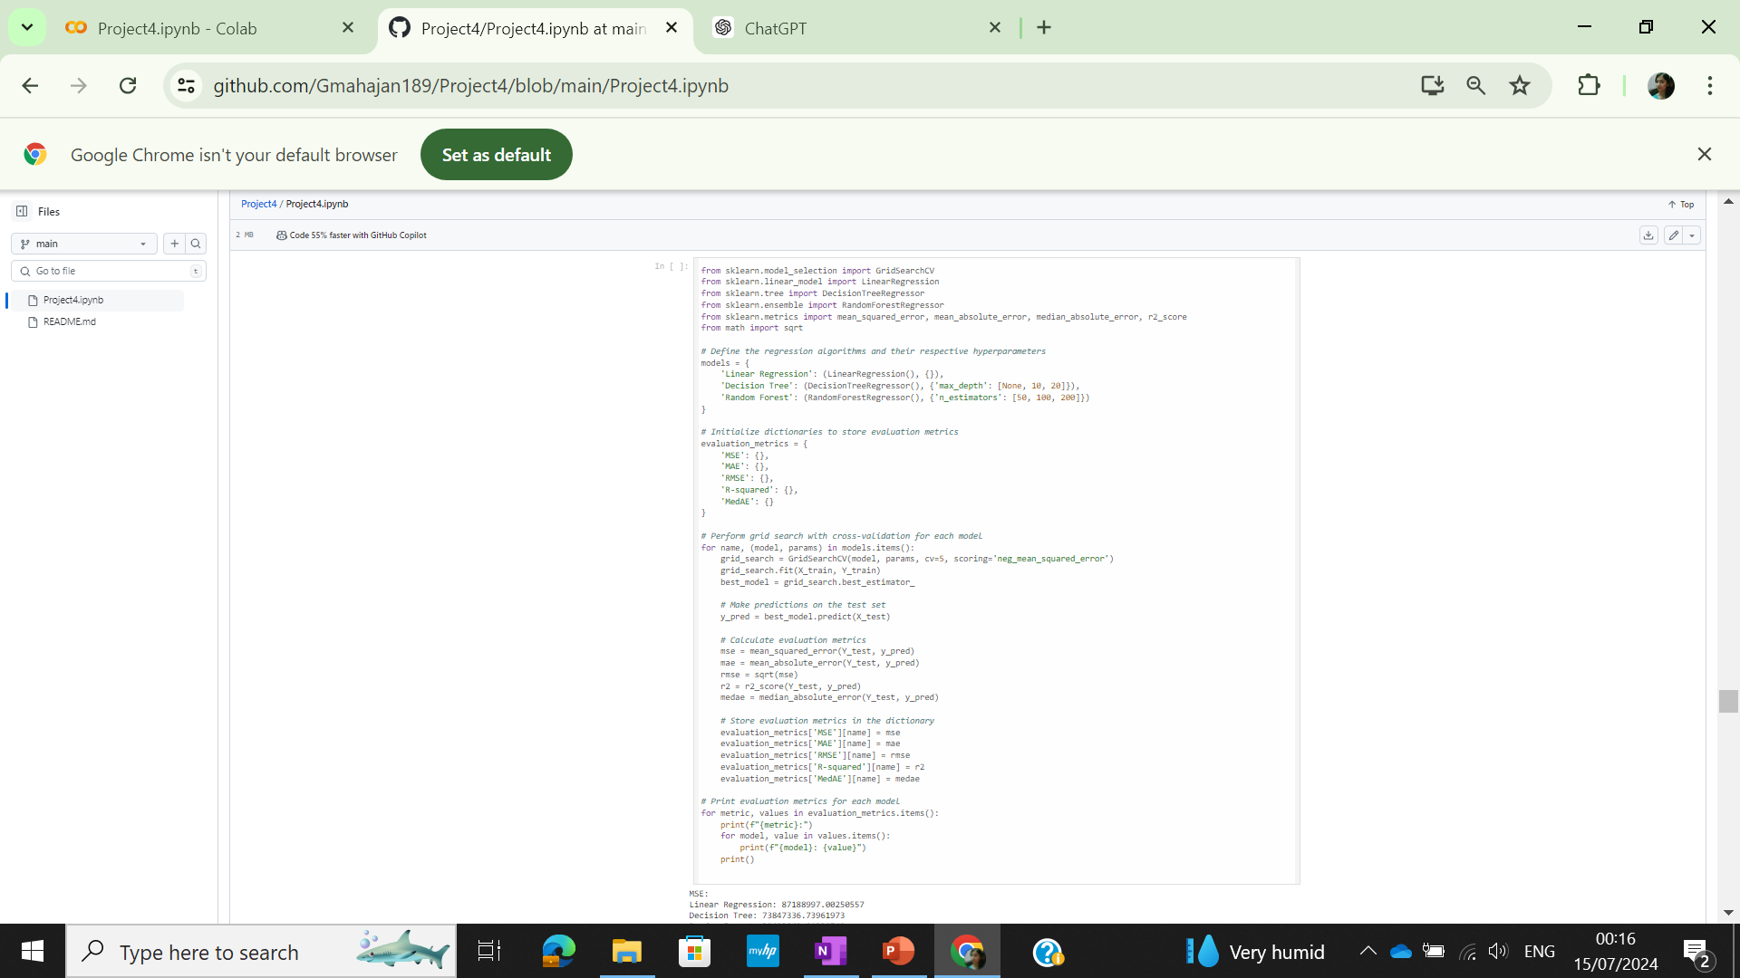
Modelling
Linear Regession,Decision Tree, Random Forest Regressor models imported
Hyperparameters defined for Decision Tree and Random Forest Regressor models
For performing a grid search with cross-validation to find the best hyperparameters for each model in a set of models
Performance metrics evaluated for the all the models

Slide 27
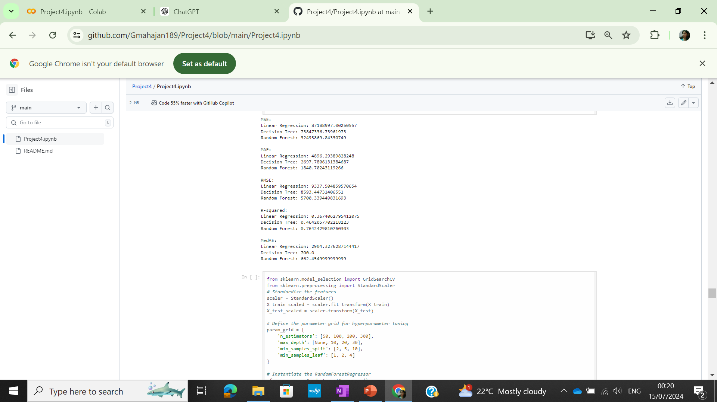
Model Evaluation
Modelling results indicate RandomForest as the best model due to lowest MAE,MSE implying less error and Highest R-Squared amongst model meaning the best fit
For performing a grid search with cross-validation to find the best hyperparameters for each model in a set of models

Slide 28
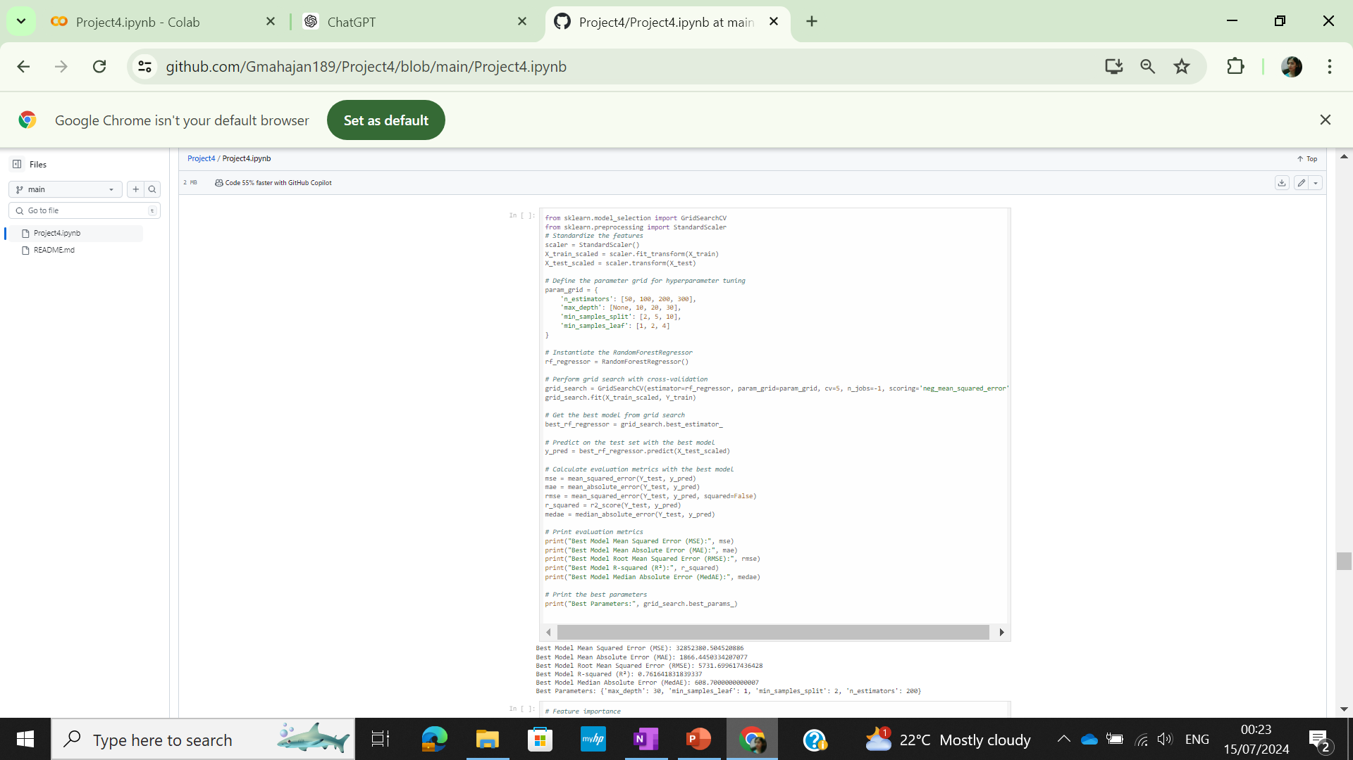
Model Hyperparameter Tuning
Hyperparameter tuning for RandomForest Regressor to find the Hyperparameters for the best fit
For performing a grid search with cross-validation to find the best hyperparameters
Performance metrics evaluated for the hyperparameters combination giving the best fit

Slide 29
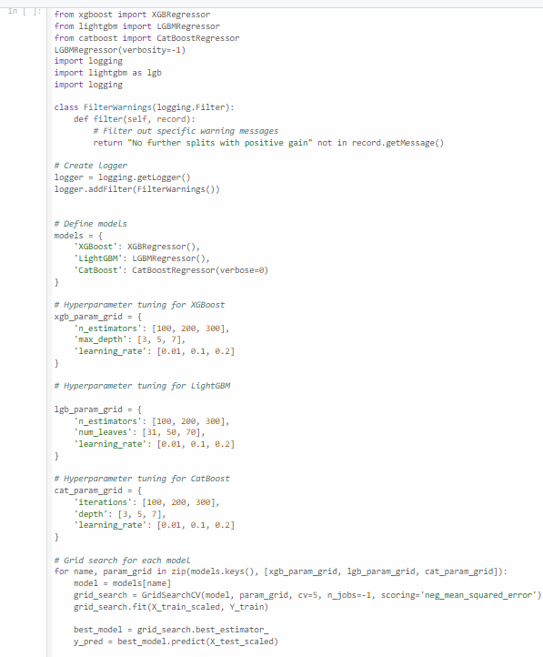
Ensemble Methods for Modelling
XGBRegressor from xgboost, LGBMRegressor from lightgbm, and CatBoostRegressor from catboost are imported for building the regression models.
Logging for logging manual messgaes
A dictionary models is defined with keys as model names and values as instances of the corresponding model objects.
GridSearchCV is instantiated with the model, parameter grid, 5-fold cross-validation (cv=5), and the scoring metric (neg_mean_squared_error).

Slide 30
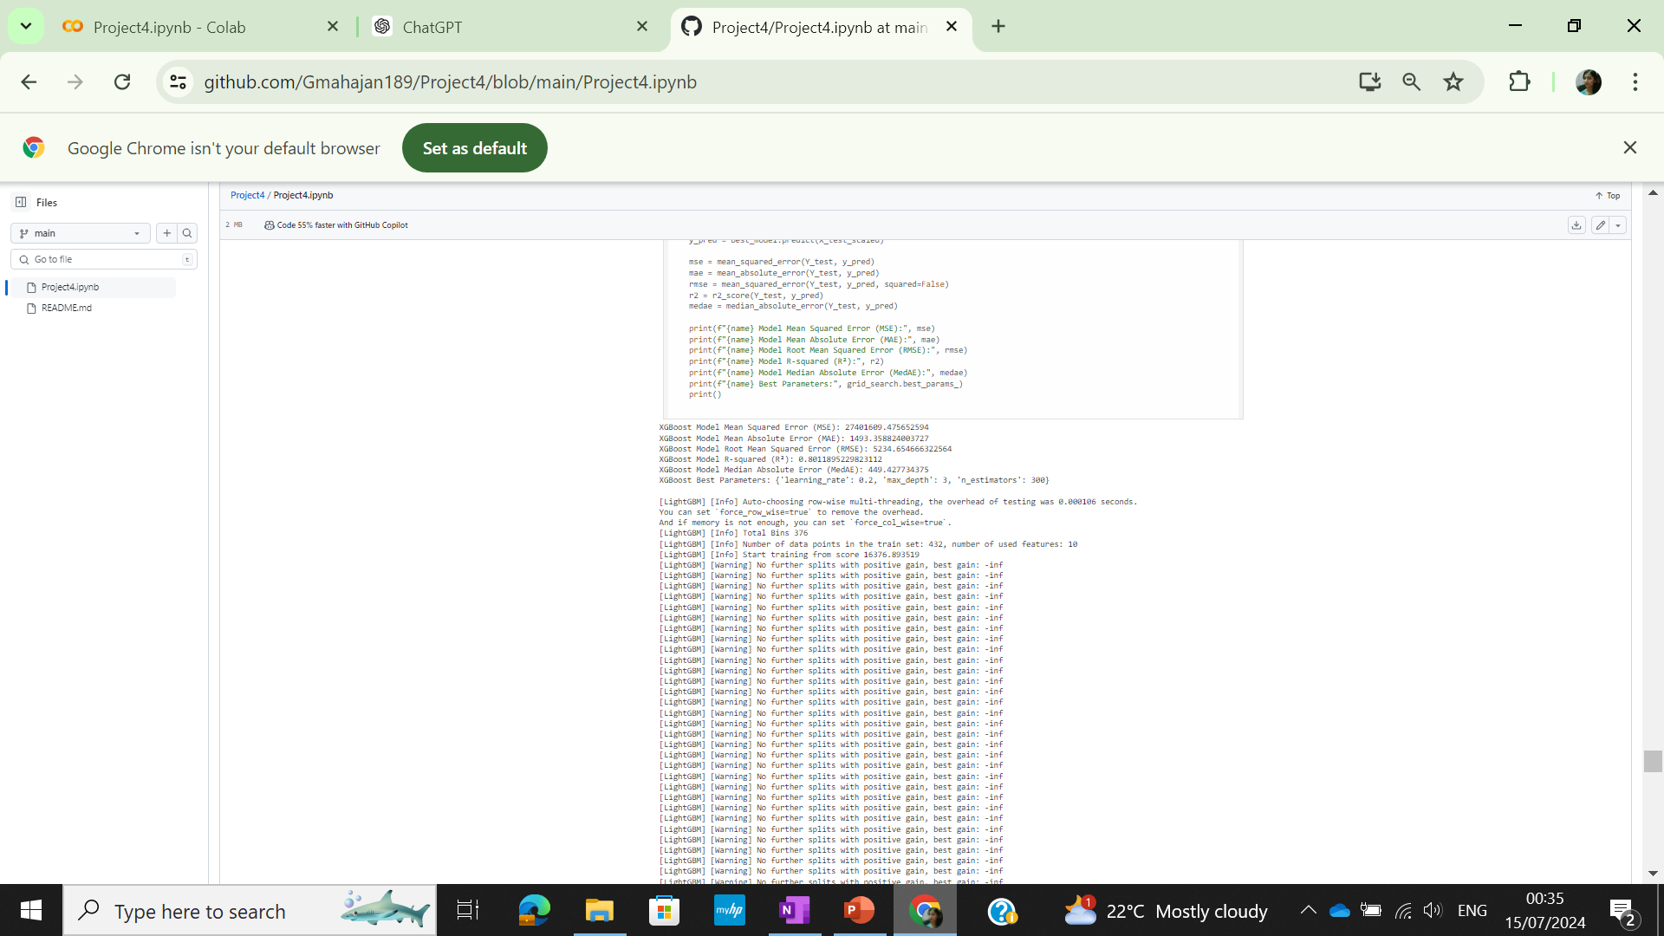
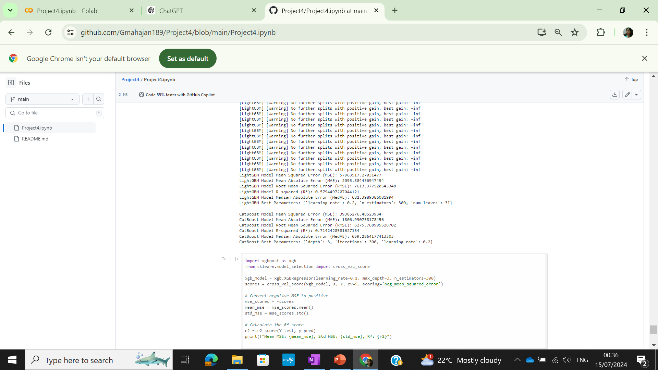
Ensemble Methods for Modelling
XGBoost model gives the lowest MAE,MSE and highest R-Squared indicating the best fit with lowest errors amongst the models

Slide 31
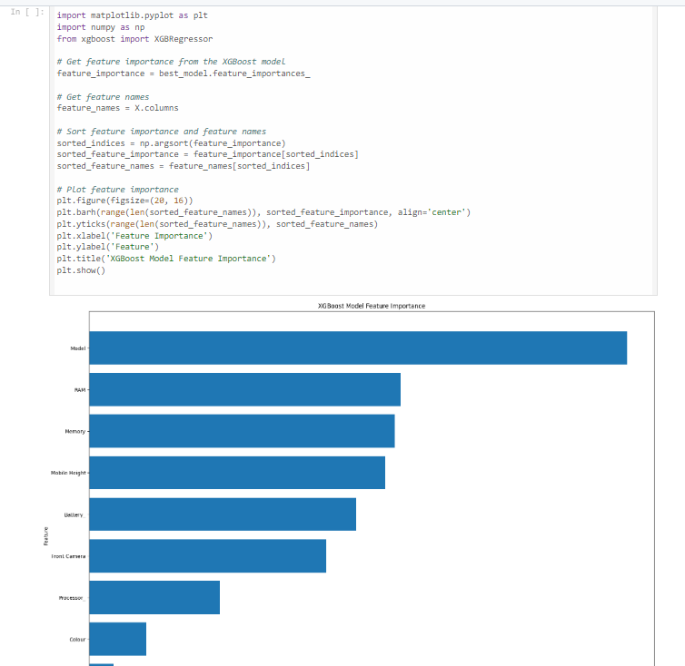
Ensemble Methods for Modelling
Feature Importance for XGBoost model barplot made indicating that Model and RAM are the most important features

Slide 32
Best Model
Based on the performance metrics , it's evident that the XGBOOST model outperforms the Linear Regression, RANDOM FOREST and Decision Tree models across multiple metrics, including lower Mean Squared Error (MSE), Mean Absolute Error (MAE), Root Mean Squared Error (RMSE), and higher R-squared value.
This suggests that the XGBOOST model provides a better fit and higher accuracy in predicting the target variable compared to the other models. Therefore, it can be concluded that thIS model is the most effective among the three for PREDICTING THE MOBILE PHONE PRICES

Slide 33
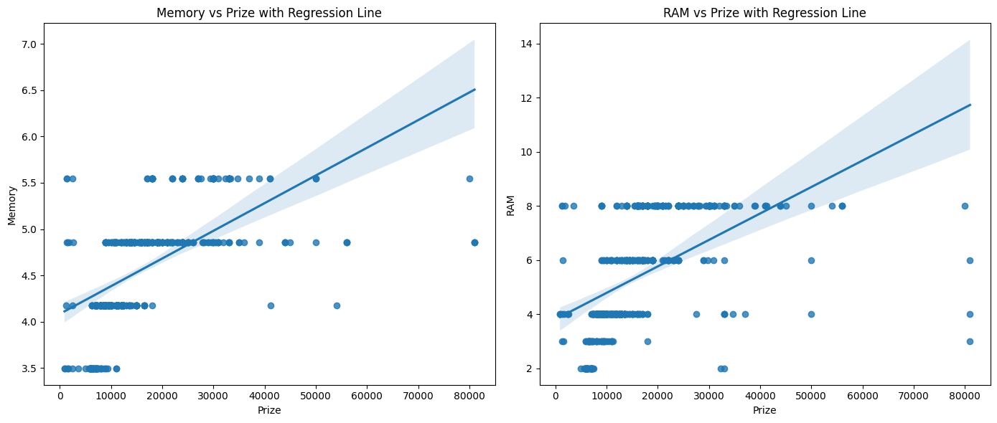
Conclusion
-Both plots suggest that as the price of the product increases, both memory size and RAM tend to increase.
-The confidence intervals suggest that there is some variability in the data, but the overall trend remains positive.
-The positive correlation implies that higher-priced products generally come with larger memory and more RAM.

Slide 34
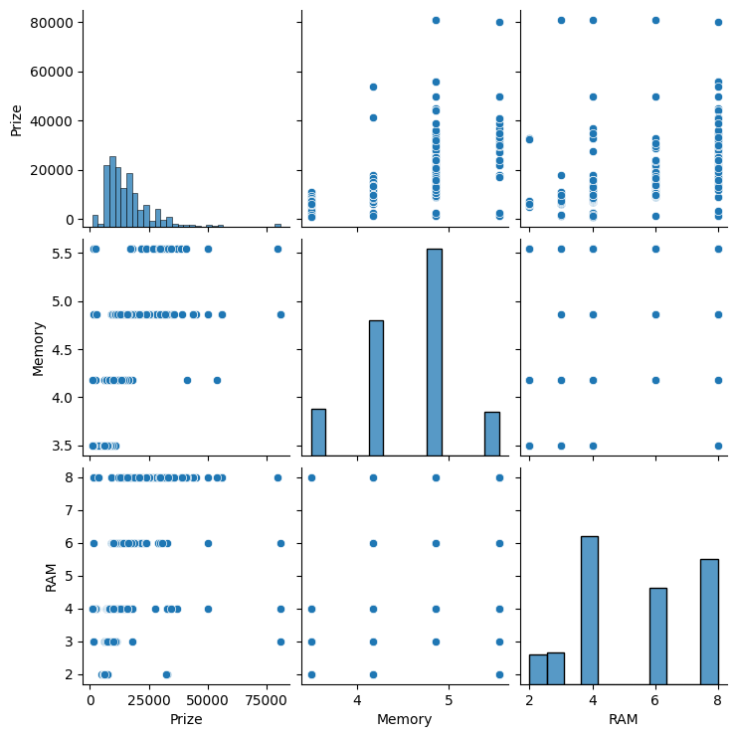
Conclusion
-There is a general trend that higher camera specifications (both rear and front) are associated with higher prizes.
-The data has outliers, especially in the camera specifications.
-The distribution of prizes is heavily skewed towards lower values, suggesting most products are priced lower, with a few high-end products priced significantly higher.

Slide 35
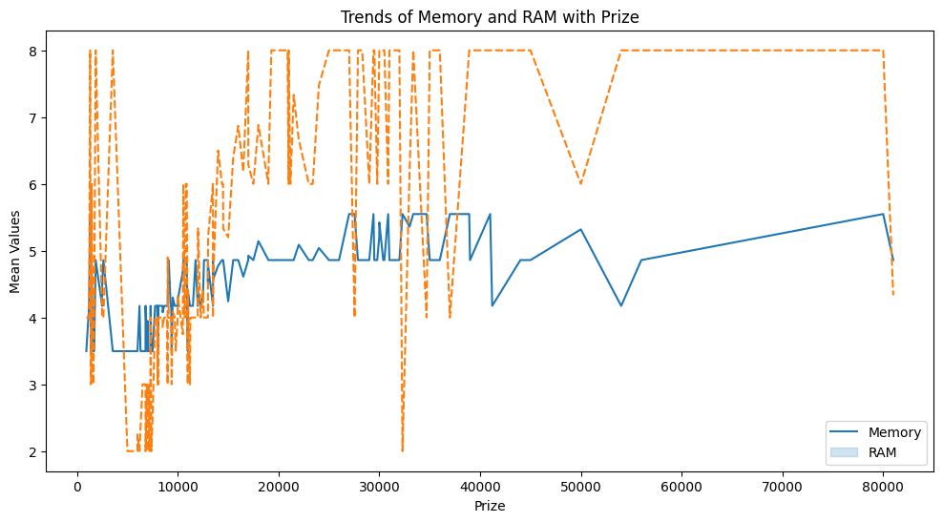
Conclusion
-The plot effectively shows that both memory and RAM increase with the prize, but memory has a more stable upward trend while RAM values are more variable.
-Understanding these trends can help in analyzing how prize impacts the specifications of products, particularly in terms of memory and RAM.

Slide 36
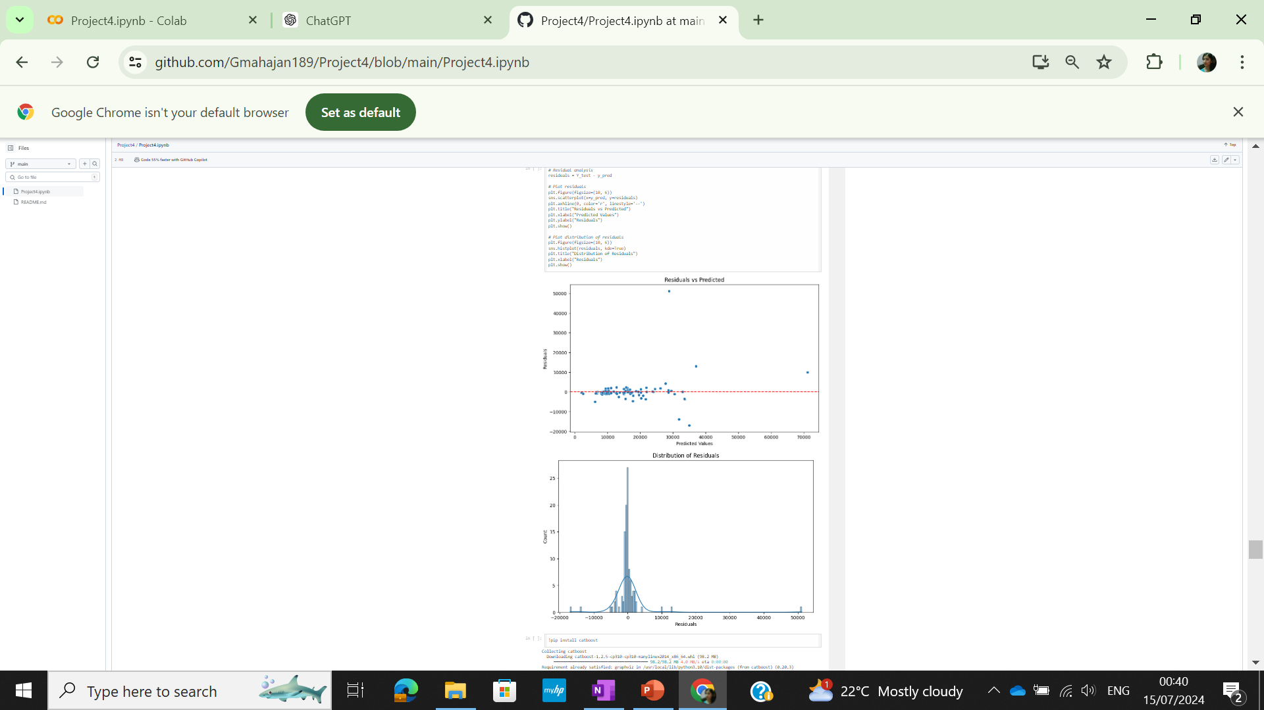
Modelling Results
Uniform distribution of residuals around zero indicates balanced errors across predicted values, ensuring the model isn't consistently over- or under-predicting.
Even spread of residuals reflects a well-fitted model, capturing data patterns effectively and providing reliable predictions.

Slide 37
THANK YOU!

